Slide 1

Stewardship
Workshop
Michigan District 2019

Slide 2

Luke 16:1–13
Parable preceded by:
1. Jesus teaching on the cost of being a disciple (14:25–35)
2. Parable of the Lost Sheep (15:1–7)
3. Parable of the Lost Coin (15:8–10)
4. Parable of the Lost Son (15:11–32)

Slide 3
Parable of the Shrewd
Manager
Who is teaching this parable?
Who is receiving this teaching and why is it relevant to them?
V. 1–9 Dishonest manager shrewdly understood his world and how to use it … he used his master’s stuff for himself and against his master.

Slide 4
V. 1 Jesus told his disciples: “There was a rich man who had a manager and charges were brought to him that this man was wasting his possessions.”
“This is the day the Lord has made; let us rejoice and be glad in it.”
It’s not yours! We’ve got nothing, it’s God’s stuff. (Is there bad stuff?) It is good.
Wasting God’s possessions … how don’t we waste God’s stuff? Lose your purpose and not change your life.

Slide 5
V. 2 “And he called him and said to him, ‘What is this that I hear about you? Turn in the account of your management, for you can no longer be manager.’”
Understand the rules for the stuff of the world and the rules for God’s stuff.
Example: Don’t try and use God’s stuff without prayer.

Slide 6
V. 3 “And the manager said to himself, ‘What shall I do, since my master is taking the management away from me? I am not strong enough to dig, and I am ashamed to beg.’”
We need to know how to use “stuff” the way the manufacturer intended. (People of the world use it under their own directions/instructions).
How do we answer the question:
  What is the purpose of the stuff we have?

Slide 7
Psalm 46:10
“Be still, and know that I am God; I will be exalted among the nations, I will be exalted in the earth.”

Slide 8
V. 4 “I have decided what to do, so that when I am removed from management, people may receive me into their houses.”
What is the goal of this world, and what is the goal of our world?
  Then learn how to use Law and Gospel appropriately in each.
  Whose house are we hoping to be welcomed into? (This is not a works/righteousness question.)
  What is the goal of this world?
  What is the goal of God’s world?

Slide 9
V. 5–7
“So, summoning his master’s debtors one by one, he said to the first, ‘How much do you owe my master?’ He said, ‘A hundred measures of oil.’ He said to him, ‘Take your bill, and sit down quickly and write fifty.’ Then he said to another, ‘And how much do you owe?’ He said, ‘A hundred measures of wheat.’ He said to him, ‘Take your bill, and write eighty.’”

Slide 10
V. 5–7
But God says only 10% to Him (OT).
  Note the shrewd manager is not concerned with percentages.

Slide 11
V. 8 “The master commended the dishonest manager for his shrewdness. For the sons of this world are more shrewd in dealing with their own generation than the sons of light.”
The Sons of this world understand their world, what resources they have to use, and how to use them better than the Sons of God know their world, what resources they have to use, and how to use them!
Shrewd guy is commended because he understood his world! He knew what he had and knew how to use it for survival.

Slide 12
V. 8
Manager commended for being shrewd (not good) with regard to the world.
  People of this world
    Of this world vs. in this world
  People of the light
    Do not know the world
    Do not know how to use this world

Slide 13
V. 9 “And I tell you, make friends for yourselves by means of unrighteous wealth, so that when it fails they may receive you into eternal dwellings.”
Figure out our contextual place as sons of God in the world. We have lost our focus and purpose … and how and why we got lost in the first place.
Use stuff of this world
  Goal of this world vs. goal of the light
  Law vs. Gospel

Slide 14
V. 10–12
“One who is faithful in a very little is also faithful in much, and one who is dishonest in a very little is also dishonest in much. If then you have not been faithful in the unrighteous wealth, who will entrust to you the true riches? And if you have not been faithful in that which is another’s, who will give you that which is your own?”

Slide 15
V. 10–12
What is the difference between:
  The “I” world
  The “I AM” world
    Takes away “If only…”

Slide 16
V. 13 “No servant can serve two masters, for either he will hate the one and love the other, or he will be devoted to the one and despise the other. You cannot serve God and money.”
You just can’t serve two masters. (Jesus himself said so! Try, try that we may.)
Two masters. Two sets of directions.
Can’t go east and west at the same time. (Polar opposites)
You cannot manage the things of God and the things of this world at the same time and in the same way.

Slide 17
V. 13
You cannot follow two masters means:
  You cannot follow two different sets of directions. You must read and follow the Manufacturer’s recommended instructions for the use of His stuff. The world’s instructions will not work on God’s stuff. Try and put together IKEA products on your own, without the instructions, and see what happens.
  If your life isn’t fitting together right … try reading the Manufacturer’s instructions first!

Slide 18
V. 13
Use by the worlds standards not manufacturer’s directions.
If you don’t follow directions you can’t get it right.

Slide 19
Key Takeaways
1. A master is master. It’s all his.
  None is ours to use our way, but His.
  Our job is to constantly monitor ourselves
    Exposure to the truth (World vs. Light) brings us back or not.
2. Don’t wait for the Master to come to you …
  It will be over. Repent!
  (Dr. Martin Scharlemann: Don’t allegorize every parable.)

Slide 20
Key Takeaways
3. We can’t follow two sets of directions at the same time.
  We can’t go east and west at the same time.
4. Why does Jesus speak so much about money/stuff and where our hearts are?
  That was the devil’s original question/temptation.

Slide 22
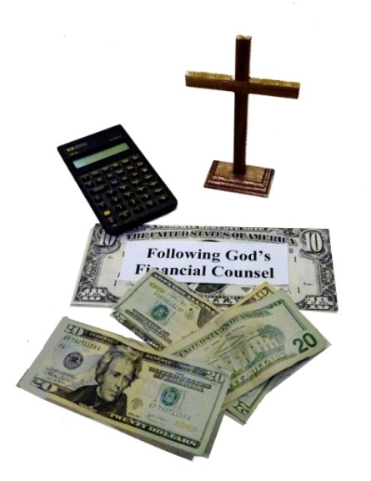
Handling Stuff in a God-pleasing Way
A Three-part Workshop:
Part 1. Serving God not Mammon
Part 2. Managing God’s Money
Part 3. Final Thoughts

Slide 23
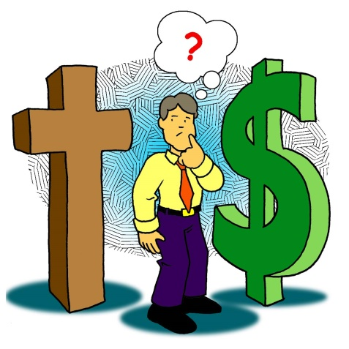
Handling Stuff in a God-pleasing Way
Introduction:
Since over 2,000 verses in Scripture relate to money and possessions, and because so much of life revolves around material possessions, it is not only fitting but essential that we seek God’s guidance and wisdom to better plan, save, spend, and give money. God wants us
to follow His financial counsel.
“Watch out! Be on your guard against
all kinds of greed; a man’s life does
not consist in the abundance of
his possessions” (Luke 12:15 NIV).

Slide 24

Handling Stuff in a God-pleasing Way
Questions to get us started:
Living in a consumer-oriented culture that teaches us always to want more, how do we, as God’s people, live counter-culturally with a detached attitude toward money and possessions?
Do you find yourself always wanting more?
Is this desire causing you to be discontent
with God’s gifts?
How do you curb your desire for more
and become content?
Do your financial decisions reflect that
serving God is your highest priority?

Slide 25
Handling Stuff in a God-pleasing Way
Whether God gives us lots of money or little, we are to steward it faithfully.
God wants us to…
Acknowledge Him as the owner of the money and possessions He entrusts to us (Psalm 24:1; Haggai 2:8).
Acknowledge that He gives us the ability to earn money (Deuteronomy 8:18).
Develop a proper view and attitude toward money (Luke 16:11). There is a powerful relationship between our spiritual condition and our attitudes and actions concerning money and possessions.

Slide 26

Handling Stuff in a God-pleasing Way
Heed God’s warnings about the lure of money and possessions (Luke 12:15).
Be faithful and trustworthy stewards of the money He entrusts to us (1 Corinthians 4:2).
Share with those in need and extend His kingdom (Galatians 6:10; Matthew 28:19–20).
Be aware that wealth can be a barrier
to spiritual growth (Matthew 19:16–25).
Understand we can’t serve God and
money (Matthew 6:24).

Slide 27
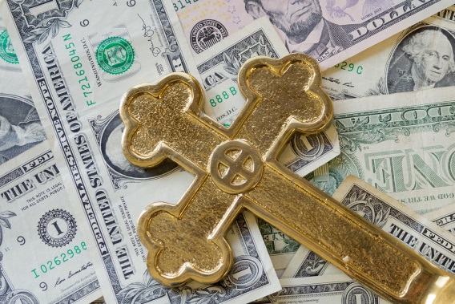
Handling Stuff in a God-pleasing Way
Use money wisely for His purposes (Matthew 6:20).
Provide for the needs of our families (1 Timothy 5:8).
Understand that money does not provide lasting happiness and contentment (Hebrews 13:5).
Understand that money and stuff can make us
proud and become our security
(Hosea 13:6).
Not store up treasures
on earth (Matthew 6:19).

Slide 28

Part 1: Serving God Not Mammon
(Breaking the Spirit of Mammon)
A. What is mammon?
B. Where/when did it start?
C. Why is it so dangerous?
D. How can you resist it?
Jesus spoke most frequently about
two things—the kingdom of God
and money. Throughout Scripture,
we are warned about the dangers of money.

Slide 29

A. What is Mammon?
The Pocket Bible Dictionary defines mammon as: “Material wealth or possessions. Christ warned that money or physical goods were false gods that should not be worshiped (Matthew 6:24). He urged believers to seek kingdom interests and promised that
their material needs would be met
(Matthew 6:33).”
Mammon is money-centered and
thing-centered rather than
God-centered.

Slide 30

A-1 Mammon as a god
Martin Luther wrote: “Many a one thinks that he has God and everything in abundance when he has money and possessions; he trusts in them and boasts of them which such firmness and assurance as to care for no one. Lo, such a man also has a god, Mammon by name, i.e. money and possessions, on which he sets his heart, and which is also the most common idol on earth. He who has money and possessions feels secure, and is joyful
and undismayed as though he were sitting
In the midst of paradise … The [care and
desire for money] sticks and clings to
our nature, even to the grave.”

Slide 31

A-2 Mammon as a god
Peter Kreft, a professor of theology at Boston College, wrote: “Mammon is the inordinate desire to possess wealth, goods or objects of abstract value with the intention to keep it for one’s self, far beyond the dictates of basic survival and comfort. It is applied to a markedly high desire for and pursuit of wealth, status, and power. Mammon is similarly an inordinate desire to acquire more than one needs … It is natural for man
to desire external things as means,
but mammon makes them into ends,
into gods...”

Slide 32

A-3 Mammon as Power
Richard Foster, a theologian and author of Celebration of Discipline, wrote, “Mammon is a power that seeks to dominate us.”
In our fallen state, we make mammon
a false god and grant it too much
power in our lives.
We find meaning in the creation
rather than in the Creator.

Slide 33
A-4 The Jealousy of Mammon
Jesus said, “No one can serve two masters. Either he will hate the one and love the other, or he will be devoted to the one and despise the other. You cannot serve both God and Money” (Matthew 6:24 NIV).
For Jesus, mammon wasn’t one idol among equals. He singled it out as direct competition to God. Once we allow money to have lordship over our lives, it becomes Money with a capital M, a god that jealously dethrones all else.

Slide 34

A-5 Resisting the Draw of Mammon
Jesus tells us that it is impossible to serve two masters.
We must not allow the lure of money and stuff to have any power in our lives.
We must not …
Submit to its power over us.
Put our trust in it.
Allow the pursuit of it to
permeate our lives.
Be transformed by it.

Slide 35
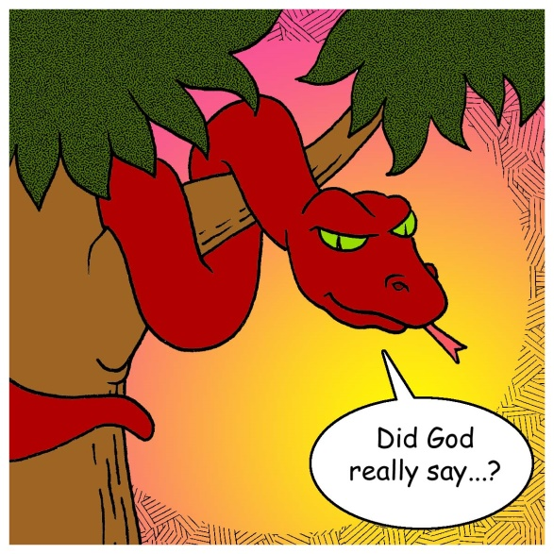
B. Where/when did it start?
Mammon starts with Satan’s lie in the Garden of Eden.
Even though God gave Adam and Eve everything they needed, Satan’s lie convinced them that there
was more apart from God.
Mammon leads us to our spiritual
poverty. Puritan Richard Baxter
said, “When men prosper in the
world, their minds are lifted up
with their estates, and they can
hardly believe that they are so ill,
while they feel themselves so well.”

Slide 36

B-1 Mammon Entices
The average American today sees more advertisements in one year than a person living 50 years ago saw in his entire life.
Each week, we …
work
watch
spend (we repeat the cycle)

Slide 37


B-2 The Lust for More
The values of thrift and modest living of three or four decades ago have changed dramatically.
“The lust for affluence in contemporary society has become psychotic; it has completely lost touch with reality” (Richard Foster).
“Where riches hold the dominion of
the heart, God has lost authority”
(John Calvin).

Slide 38

C. Why Is Mammon so Dangerous?
Allowing ourselves to be dependent on mammon instead of God, we become inflated with pride in our stuff. We allow mammon to puff us up. Jesus said, “For where your treasure is, there your heart will be also” (Matthew 6:21).
The world seems to be doing a better job of making people disciples of the world than the church in making disciples of Jesus. Our culture is
carefully and intentionally
discipling us.

Slide 39

C-1 Mammon Separates
We allow mammon to separate us from God. It is slow. It is seductive. It is subtle.
It makes sense to our carnal minds, but it leads us away from God.
“For the love of money is a root of all kinds of evils. It is through this craving that some have wandered away from the faith and pierced themselves with many pangs”
(1 Timothy 6:10).

Slide 40
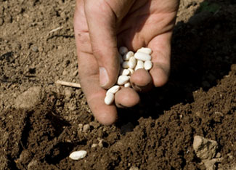
C-2 Mammon Distorts
In the Parable of the Sower, Jesus tells us some seed fell among the thorns. “They are those who hear the word, but the cares of the world and the deceitfulness of riches and the desires for other things enter in and choke the word, and it proves unfruitful” (Mark 4:18).
Mammon can distort our thinking:
God has created all things and owns
all things (Psalm 24:1). In our
sinfulness, we believe that we are
the owners. In defiance of God, we
ignore His wisdom and allow the
deceitfulness of the world to capture our minds.

Slide 41

C-3 Mammon Focuses on Self
The path of mammon is a path away from God. Mammon lures us out of dependence on God and into self-dependence and puts us into a state of enmity to God. Our satisfaction is apart from God.
Mammon destroys our compassion (Luke 12:15).
We develop a scarcity mentality. Mammon closes our hearts to God and others.

Slide 42

C-4 God is Displaced by a god
The Apostle Paul wrote:
“Put to death therefore what is earthly in you: sexual immorality, impurity, passion, evil desire, and covetousness, which is idolatry” (Colossians 3:5). The love and coveting of mammon is a violation of the first commandment (You shall have no other gods).
Whatever we set our hearts on, other
than God, becomes our God.

Slide 43

D. How Can You Resist It?
In 1 Timothy 6:17 Paul wrote, “As for the rich in this present age, charge them not to be haughty, nor to set their hopes on the uncertainty of riches, but on God, who richly provides us with everything to enjoy. They are to do good, to be rich in good works, to be generous and ready to share, thus storing up treasure for themselves as a good foundation for the future, so that they make take hold of that which is truly life.”

Slide 44
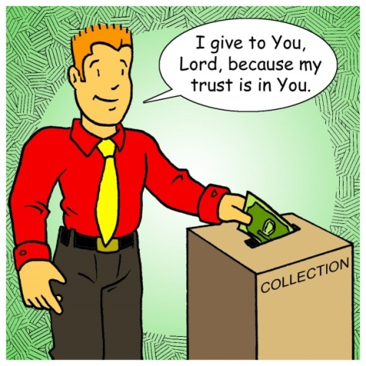
D-1 The Antidote to Mammon
Is Giving
Rev. Kent Hughs, author of the best-selling book Disciplines of a Godly Man, said, “Every time I give I declare that money does not control me. Generosity is a perpetual de-deification of money.”
Every time we give, we deny the spirit of mammon and honor the Lord. Giving is an ongoing act of
worship.
John Wesley, founder of the Methodist
Church, wrote, “Money never stays
with me. It would burn me if it did. I
throw it out of my hands as soon as
possible, lest it should find its way
into my heart.”

Slide 45
D-2 Giving Focuses on God
Jesus said, “It is more blessed to give than to receive” (Acts 20:35). It is more blessed to do good and to give with what we have, be it much or little, than to increase it and make it more. Through our giving, we become more like God Who gives and continues to give.
Through our faithful and generous giving, we become more God-centered rather than self-centered. “You will be enriched in every way to be generous in every way, which through us will produce thanksgiving to God” (2 Corinthians 9:11).

Slide 46

D-3 The Economy of Giving
Scripture shows us a different economy than in the world. In Acts 4:32–35, we see God’s grace at work powerfully among the people. The grace of God was producing an alternative society.
As we spend time in God’s Word, the Holy Spirit changes and renews us so we can see God at work in our lives. We are thankful for His love and goodness to us,
which compel us to show our
gratitude in thought and actions.
“Giving blesses the soul, edifies the
church, and magnifies the Lord”
(Rev. Steve Olford, a pioneer in
Christian television).

Slide 47

Part 2: God’s Money Managers
Are we thinking and acting like God’s money managers? Or are we living foolishly and wastefully, taking our cues from the world, which neither knows nor cares what God wants us to do with His money and possessions?
Martin Luther wrote, “There
are three conversions necessary
in the Christian life: the
conversion of the heart, the mind,
and the purse.”
Billy Graham wrote, “If a person gets his attitude toward money straight, it will straighten out almost every other area in his life.”

Slide 48
Money Impacts Us Spiritually
Scripture reveals the powerful relationship between our true spiritual condition and our attitude and actions regarding our money and possessions. How we handle money is an index to the state of our spiritual lives.
Rev. Randy Alcorn, author of the Treasure Principle, wrote, “Thousands of verses of Scripture talk directly or indirectly about money and possessions and how God’s people should use them. The sheer enormity of the Bible’s teaching on this subject screams for our attention.”

Slide 49

God Equips Us to Manage Money
In order for us to serve as God’s money managers, we need to acknowledge God’s ownership. Not only does God own everything, but He gives us money-making and money-managing skills.
The question we should be asking is:
“God, what do You want me to do
with Your money and possessions?”
Is God really interested in your money and stuff? Does He notice how you handle your financial affairs? Is it really any of His business anyway? All these questions are answered with an emphatic, “Yes!”

Slide 50

Money Is a Tool to Support Ministry
Our money is a tool to be used in our obedience to God’s command: “Go therefore and make disciples of all nations…” (Matthew 28:19). Financial support aides us in spreading the Gospel. According to an old stewardship phrase, “Stewardship without mission is unnecessary and mission without stewardship is impossible.” Stewardship and mission are inseparable. The funding of the Great Commission needs to come from believers.
The money which God entrusts to us
has many purposes, and the funding
of mission work is of first importance.

Slide 51
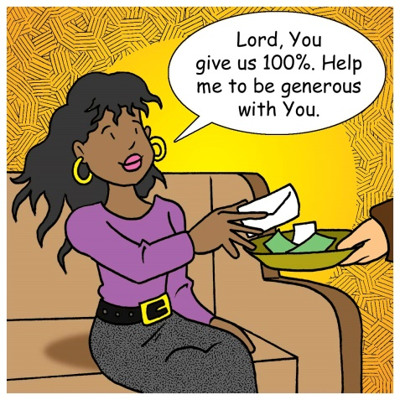
Money Is a Tool to Serve Others
Jesus calls us to use the money entrusted to us strategically. Money can be a tool for Christ. He said that we are to “make friends for [ourselves] by means of unrighteous wealth, so that when it fails they may receive [us] into the eternal dwellings” (Luke 16:9).
Jesus said, “Truly I say to you, as you did it to one of the least of these my brothers, you did it to Me”
(Matthew 25:40).

Slide 52
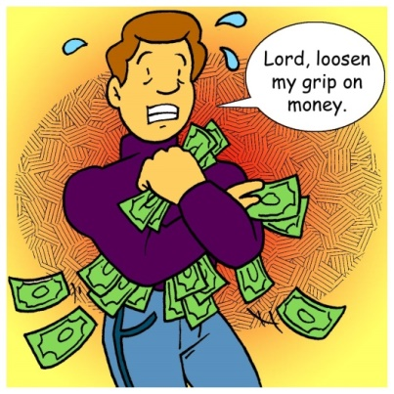
Five Important Points the Bible Makes about Money:
1. How we view money.
God’s Word is very clear that God has
created all things. God is the creator and
owner. Nowhere in Scripture does it say
that God has transferred His ownership back to us, only that we are to be His stewards. Everything we have is on loan from God. In Psalm 24:1 we read, “The earth is the Lord’s and the fullness thereof, the world and those who dwell therein.”

Slide 53
2. How we feel about money.
We are told that we can’t serve God and money (Matthew 6:24), and God’s Word tells us that it is wrong to love money. “For the love of money is a root of all kinds of evils” (1 Timothy 6:10). Loving money can cause us to wander from our faith, experience many pangs, and suffer many things.
3. How we receive money.
The Bible encourages hard work and diligence. God gives us the ability to earn and make money. Our income should come from honest hard work and not from get-rich schemes.

Slide 54
4. How we spend money.
Unfortunately, many of us over-spend. God’s Word makes clear that we are to provide for our family and relatives (1 Timothy 5:8). We are also called to care for those in need. God’s Word encourages us to save money. It also warns us about debt and urges us to pay debt back as quickly as possible (Proverbs 22:7; Romans 13:8).
5. How we give money.
Through our faithful giving, we give evidence of our love, trust, and faith in the Lord for Who He is and for all that He has done for us (2 Corinthians 8:8). We give cheerfully and generously out of gratitude. Giving expresses our worship. Our giving honors and pleases God (2 Corinthians 9:11–13).

Slide 55
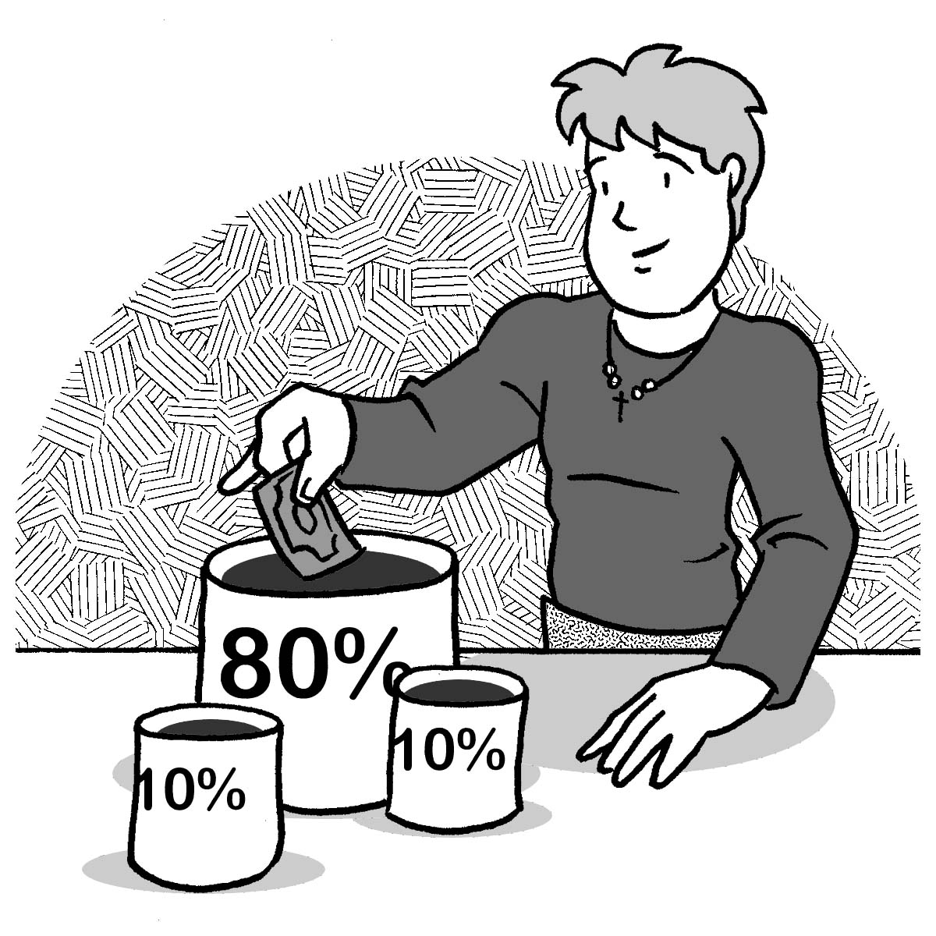
Embracing the 10-10-80 Principle
The 10-10-80 Principle can guide us in our giving, saving, and spending.
However, most of us
Over-spend: We escalate
luxuries into necessities.
Under-save: We procrastinate,
and we lack planning and discipline.
Under-give: Because of over-spending and possibly even over-saving, God’s work languishes from lack of funds.

Slide 56
God Initiates Giving
We give because God first gave to us.
It’s a good thing God did not under-give. We are saved for all eternity because He “loved the world so much that He gave His only Son…” (John 3:16). And when we give money away, we break its power over us, meet the needs of others, and glorify God. You can go to the bank on this: You cannot be fulfilled unless you are giving of your financial treasures. God gives us a desire to give, and we are “enriched in every way to be generous in every way” (2 Corinthians 9:11).

Slide 57

Part 3: Final Thoughts
The Story of Mammon
Why are we here? Pleasure
What’s gone wrong? Lack
What’s going to fix things? More
How will it look when it is? Luxury/success
(Rev. Jon Tyson)

Slide 58
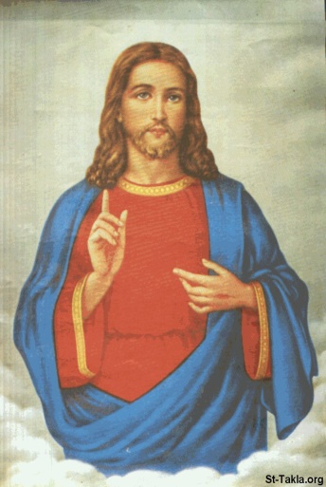
Final Thoughts
The Kingdom Story
Why are we here? God
What’s gone wrong? Sin
What’s going to fix things? Jesus
How will it look when it is? Restoration of all things through the Gospel

Slide 59

Final Thoughts
God loves us and forgives us. Even though we mismanage the money He entrusts to us and give less than our ability, we are, by grace through faith, forgiven.
As we seek God’s wisdom and guidance, He empowers us to follow His financial counsel.
May God helps us all hear Him say, “Well done, good and faithful servant!” (Matthew 25:23).

Slide 60
www.michigandistrict.org

